Slide 1

LEGO Sets Investment Decisions
Mark Dziuban

Slide 2

Objective
Every LEGO set is an investment in FUN!
LEGO sets are a fun and unique form of investment
GOAL: Predict whether a set will be a good investment

Slide 3
Definitions
Set
Over 25 pieces
No Minifig
No Books
No Games
Good Investment
Better than or equal to growth rate of S&P 500 (~10%)
Liquidity is a concern (add 2%)

Slide 4

Labeling Data
Only retired sets
Calculate Average Rate of Return:
(Current Price - Retail Price) / Retail Price
Rate of Return > S&P 500 → Good Investment
Rate of Return < S&P 500 → Not Good Investment

Slide 5
Model Selection
Random Forest Classifier
Unbalanced dataset
Missing data
Reduce Overfitting

Slide 6

Important Features
Pre-1980
1980’s
Price / Piece
Retail Price
Color Ratio
Pinks/Blues

Slide 7
Model Results
86%
2%
Don’t Invest
ACTUAL
4%
8%
Invest
Don’t Invest
Invest
PREDICTED

Slide 8

Model Results – unbalanced dataset
Precision: 87.9%
Recall: 68.6%
F1 score: .77

Slide 9
Calculating Error Costs
LEGO Set Average Annual Rate of Return: 6.72%
Assume investment of $100 over 20 years

Slide 10
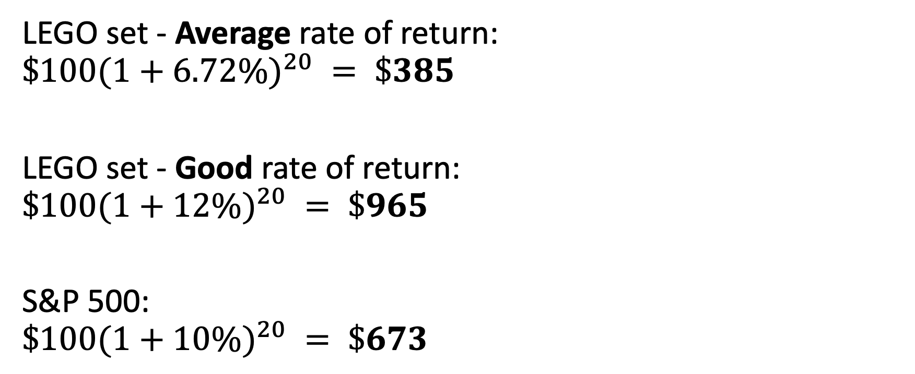
Investment Comparison
LEGO set - Average rate of return:
$${\$100(1+6.72\%)}^{20} = \$385$$
LEGO set - Good rate of return:
$${\$100(1+12\%)}^{20} = \$965$$
S&P 500:
$${\$100(1+10\%)}^{20} = \$673$$

Slide 11
Model Results – Opportunity Cost
$385 – 673 =
Don’t Invest
$288
LEGO Average: $385
LEGO Good: $965
S&P 500: $673
ACTUAL
$673 – 965 =
$965 – 673 =
Invest
$292
$292
Don’t Invest
Invest
PREDICTED

Slide 12

Model Evaluation
Set | Predicted | Actual | Price/Piece | Retail Price | Color Ratio | Pinks/Blues | Pre-1990
Adventurer’s Plane | No | Yes | $0.108 | $2.49 | .391 | -9 | No
Speed Splash | No | No | $0.103 | $2.99 | .392 | -11 | No
Astro Dart | Yes | Yes | $0.083 | $2.49 | .166 | -5 | Yes

Slide 13

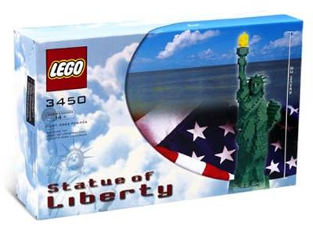
Model Evaluation - Successes
 | 1992 | Current Value
Galactic Scout | $2 | $43
 | 2000 | Current Value
Statue of Liberty | $200 | $3500

Slide 14

Other Considerations
Storage Costs
Better to purchase sets at or near retirement
(the set’s retirement, not yours)
This presentation is not financial advice and is only to demonstrate the value of modeling this data.
Could be modified for other classification problems:
Marketing
Finance

Slide 15

References:
Data Scources:
https://www.brickeconomy.com/
https://rebrickable.com/
LEGO png images: https://www.cleanpng.com/png-amazon-com-lego-minifigures-the-lego-group-lego-732331/download-png.html

